Slide 1
Know your Face Recognition data

Slide 2
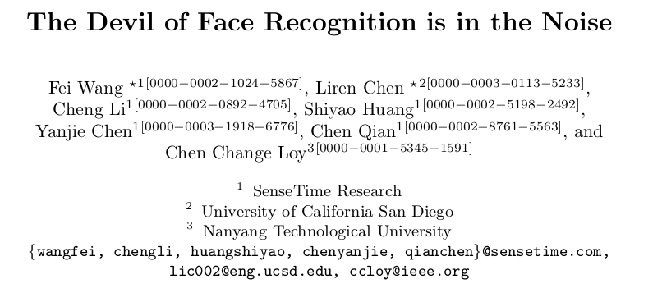

Slide 3
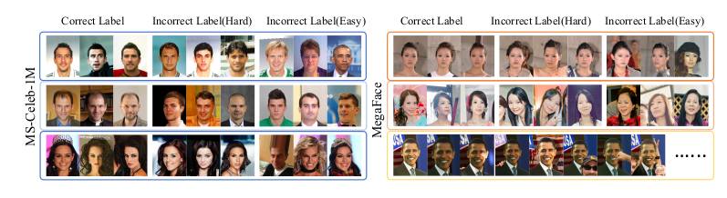
Problem
Large Face Recognition datasets (MegaFace, MS-Celeb-1M) required for training strong convolutional network, are creating using automatic/semi-automatic methods, thus contain large amount of labe noises.
labels flip: sample has been given wrong label of another class within the dataset.
outliers: sample does not belong to any of the classes within dataset, but mistakenly has one of their labels.

Slide 4
Contribution
Analyze the effect of noisy labels on Face Recognition networks.
Contribute relatively large manually cleaned dataset - IMDB-Face.
Analyze of labeling methods efficiency.

Slide 5
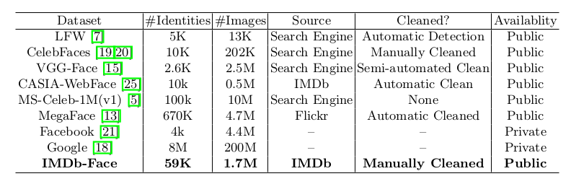
Datasets Overview
LFW - 13K images : 1.6K ID, collected from Yahoo News, running Viola-jones detector. Limited by detector most of faces are frontal. Considered sufficiently clean.
CASIA-WebFace - 500K images : 10K ID, collected from IMDB, semi-automatically cleaned via tag-constrained similarity clustering.
MS-Celeb-1M - scrapping from public search engines, approximately 100 images per ID. the data is deliberately left uncleaned.
MegaFace - based on YFCC100M dataset collected from Flickr, semi-automatic cleaned.

Slide 6
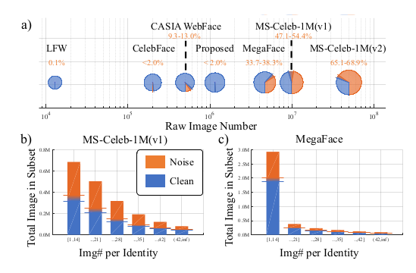
Signal to Noise Ratio
Manually cleaned subsets:
2.7M from MegaFace.
3.7M from MS-Celeb-1M
Casia / CelebFaces 30 Id’s.
Face recognition datasets with more than million samples have a noise ratio higher than 30%.
Imdb-Face: manually cleaned by workers, with approximated noise level under 2%.

Slide 7
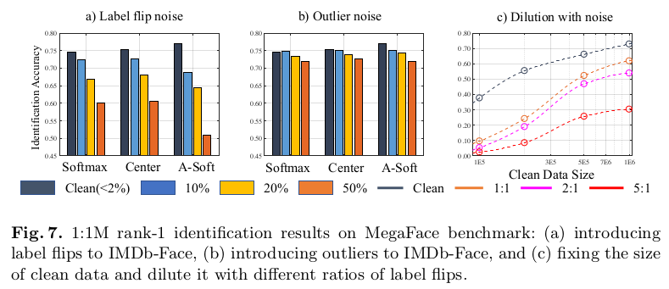
Experiment
Attention-56, batch-size of 256, 256D feature.
Imdb-Face dataset.

Slide 8
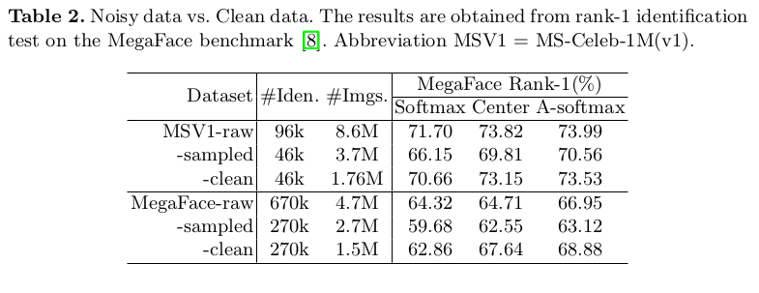
average improvement of accuracy between clean and sampled is 4.14%.
close and in some cases better results than the larger raw dataset.

Slide 9
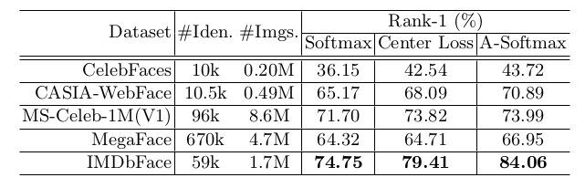
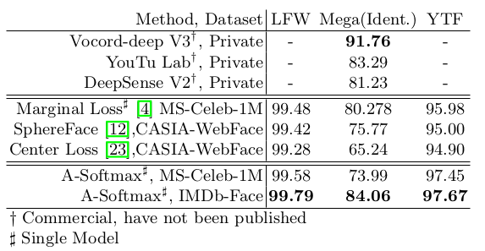
Training with different datasets:
Comparison to SOTA?? :

Slide 10


Slide 11
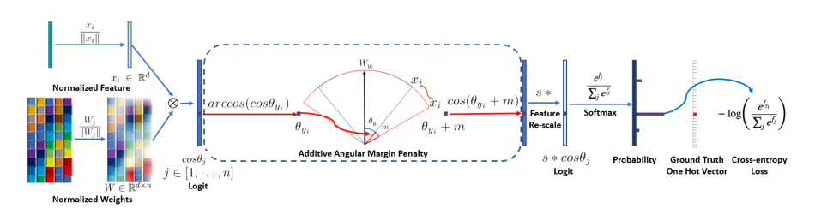
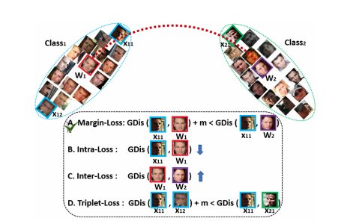

Arc Loss
s - hypersphere radius
n - number of classes (identities)
m - additive margin parameter
x - normlized features embeding
W - norrmalized weight class
Ø - angle between x and W
N - batch size

Slide 12
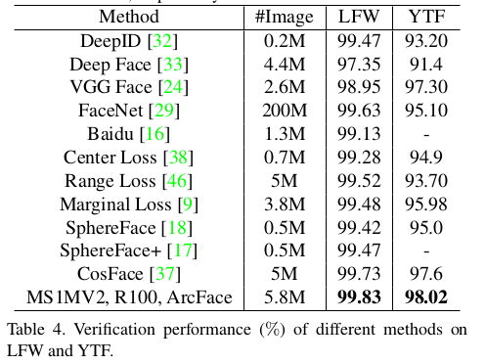
Arc Loss
s = 64, m= 0.5
MS1MV2 - Semi Automatic refined version of MS-Celeb-1M dataset

Slide 13
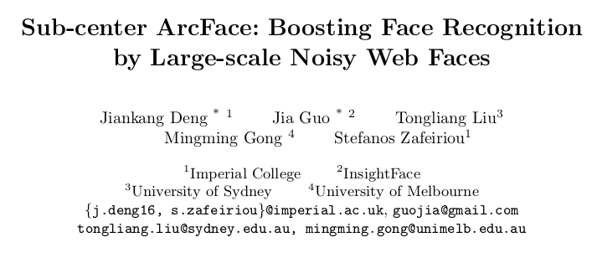

Slide 14
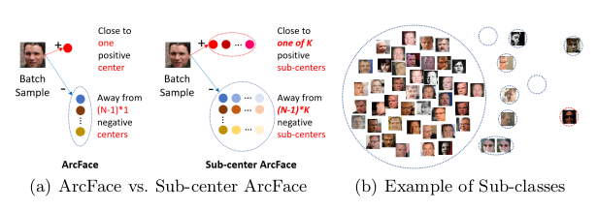
Even though ArcFace is efficient, this method assume that training data is clean.
Reduce the intra-class constraint, and improve the robustness to label noise.
Design of K-sub-centers for each class.
Most of clean faces will be close to a dominant sub-class, and non-dominant sub classes will include noisy faces.

Slide 15
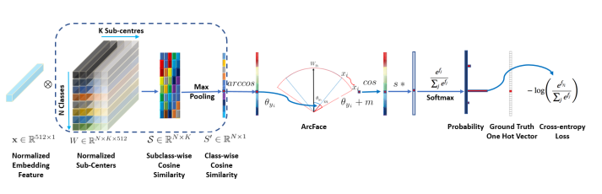
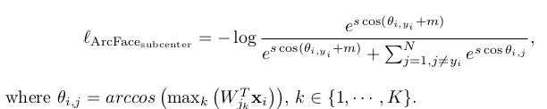

Slide 16
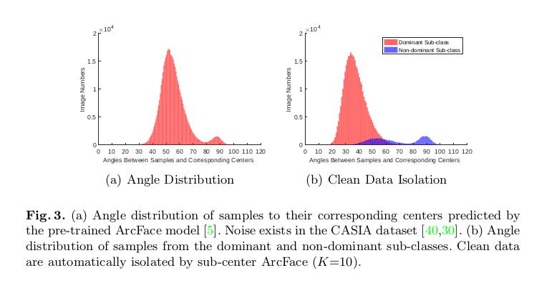
Casia-Webface distribution

Slide 17
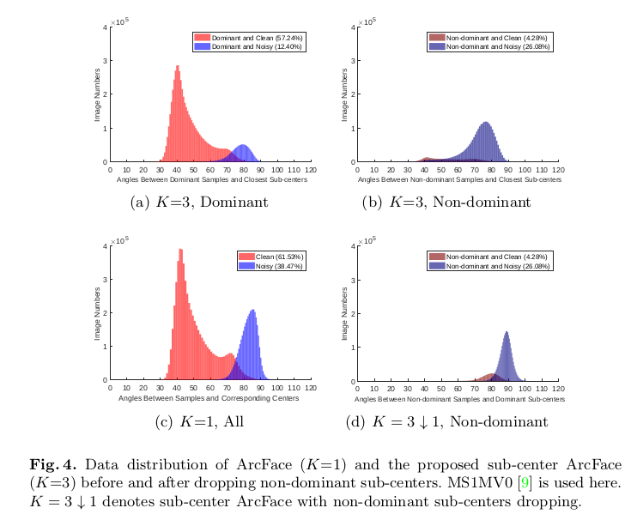
MS1MV0 (raw) distribution
estimated noise: 47.1% ~ 54.4%
Training ResNet-50, MS1MV0, ArcFace
“clean” and “noisy” are defined by MS1MV3 semi-automatic cleaned dataset.
Sub-center ArcFace reduce noise from 38.47% to 12.40%.
Angle threshold between 70 and 80 can be easily searched to drop most noisy samples.

Slide 18
Proposed training flow
Training Network using Sub-center ArcFace with K sub-classes, K>1.
After enough discriminative power, we can clean the dataset by droping all no-dominant sub-classes, and using angle-threshold Øt.
Retrain Network from scratch with the cleaned dataset, with no sub-classes, for example denoted as K = 3 ↓ 1

Slide 19
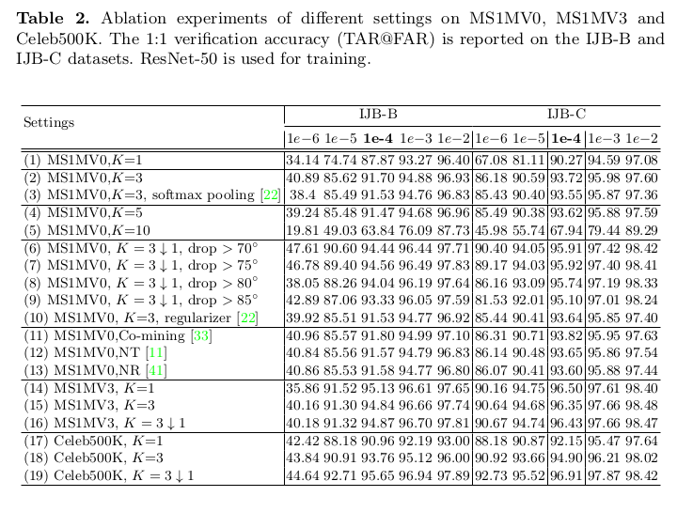

Slide 20
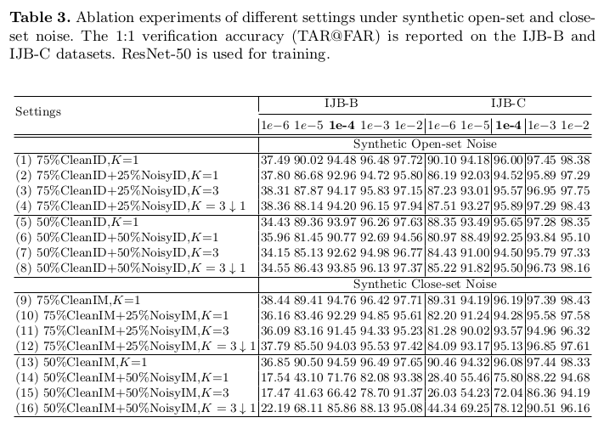
Adding synthtic noise and training ResNet-50 on clean MS1MV3.
open-set: 75% of Id’s remain clean, other are assigned with random labels. (outliers)
close-set: randomly select 25% images of each Id and assign random labels. (label-flips)

Slide 21
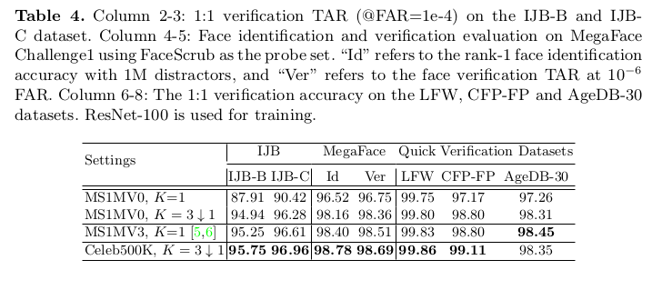

Slide 22
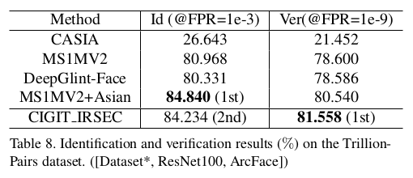
Ethnicity Bias ??
When combining all identities from MS1MV2 and Asian celebrities from DeepGlint, Arc-Face achieves the best identification performance 84.840%.

Slide 23
Future improvements
Train with Imdb-Face dataset, large mannual cleaned.
Train with larger datasets such as, CelebFace500K or other, using Sub-Center ArcFace to relax intra-classes noise.
Scraping more data on search engines and imply ethnicity bias, regarding the mission.
Adding our labeled data, to imply ethnicity bias.

Slide 24
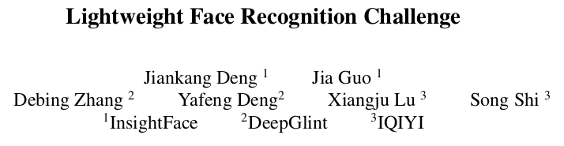
Appendix - MS1MV3 (our dataset training)
Cleaned from raw MS-Celeb-1M
face images are pre-processed to the size of 112 × 112 by the five facial landmarks predicted by RetinaFace.
Semi-automatic refinement by employing the pre-trained ArcFace model and ethnicity-specific annotators.
Named also MS1M-RetinaFace, and contains 5.1M images of 93K identities.

